Slide 1



National TB Elimination Programme
Post Treatment Follow-up
Dr R. R. Vaidya
Joint Director (TB) and State TB Officer
Department of Health and Family Welfare
Government of Gujarat

Slide 2


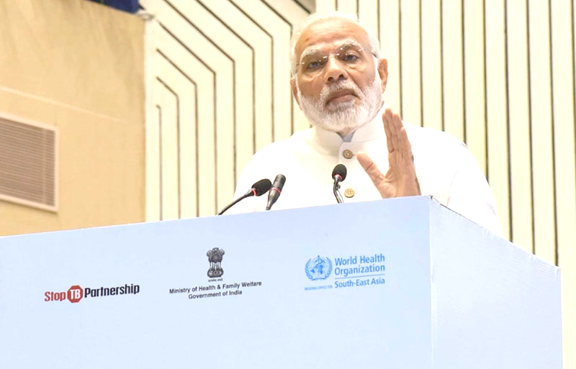
Vision, Goal and Objectives of NTEP
Vision:
India free of TB
Goal:
End the TB epidemic in India by 2030
 |  |  | TARGETS
 | INDIA |  | SDG | End TB
 | 2025 |  | 2030 | 2035
Reduction in number of TB deaths Compared with 2015 (36 deaths per 1 lakh ) | 90% (3 per lakh) |  | 90% | 95%
Reduction in TB incidence rate Compared with 2015 (217 cases per 1 lakh) | 80% (44 per lakh) |  | 80% | 90%
Reduce catastrophic costs due to TB 32% catastrophic cost | 0% |  | 0% | 0%
 |  |  | TARGETS
 | INDIA |  | SDG | End TB
 | 2025 |  | 2030 | 2035
Reduction in number of TB deaths Compared with 2015 (%) | 90% |  | 90% | 95%
Reduction in TB incidence rate Compared with 2015 (%) | 80% |  | 80% | 90%
TB-affected families facing catastrophic costs due to TB (%) Compared with 2015 (%) | 0% |  | 0% | 0%

Slide 3
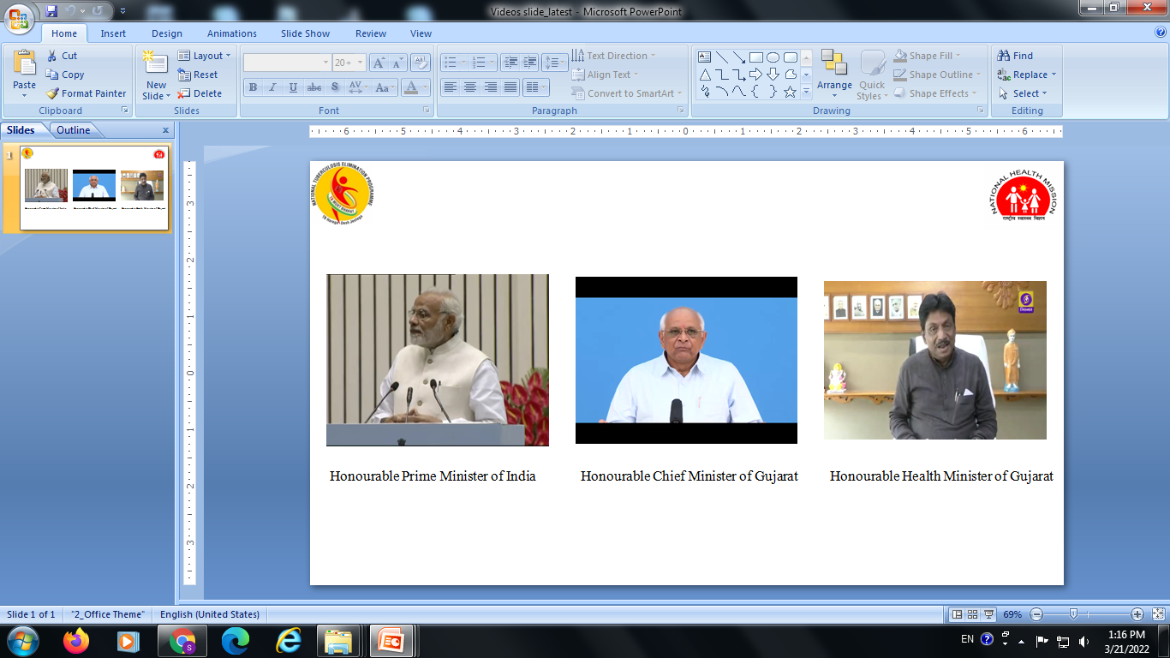
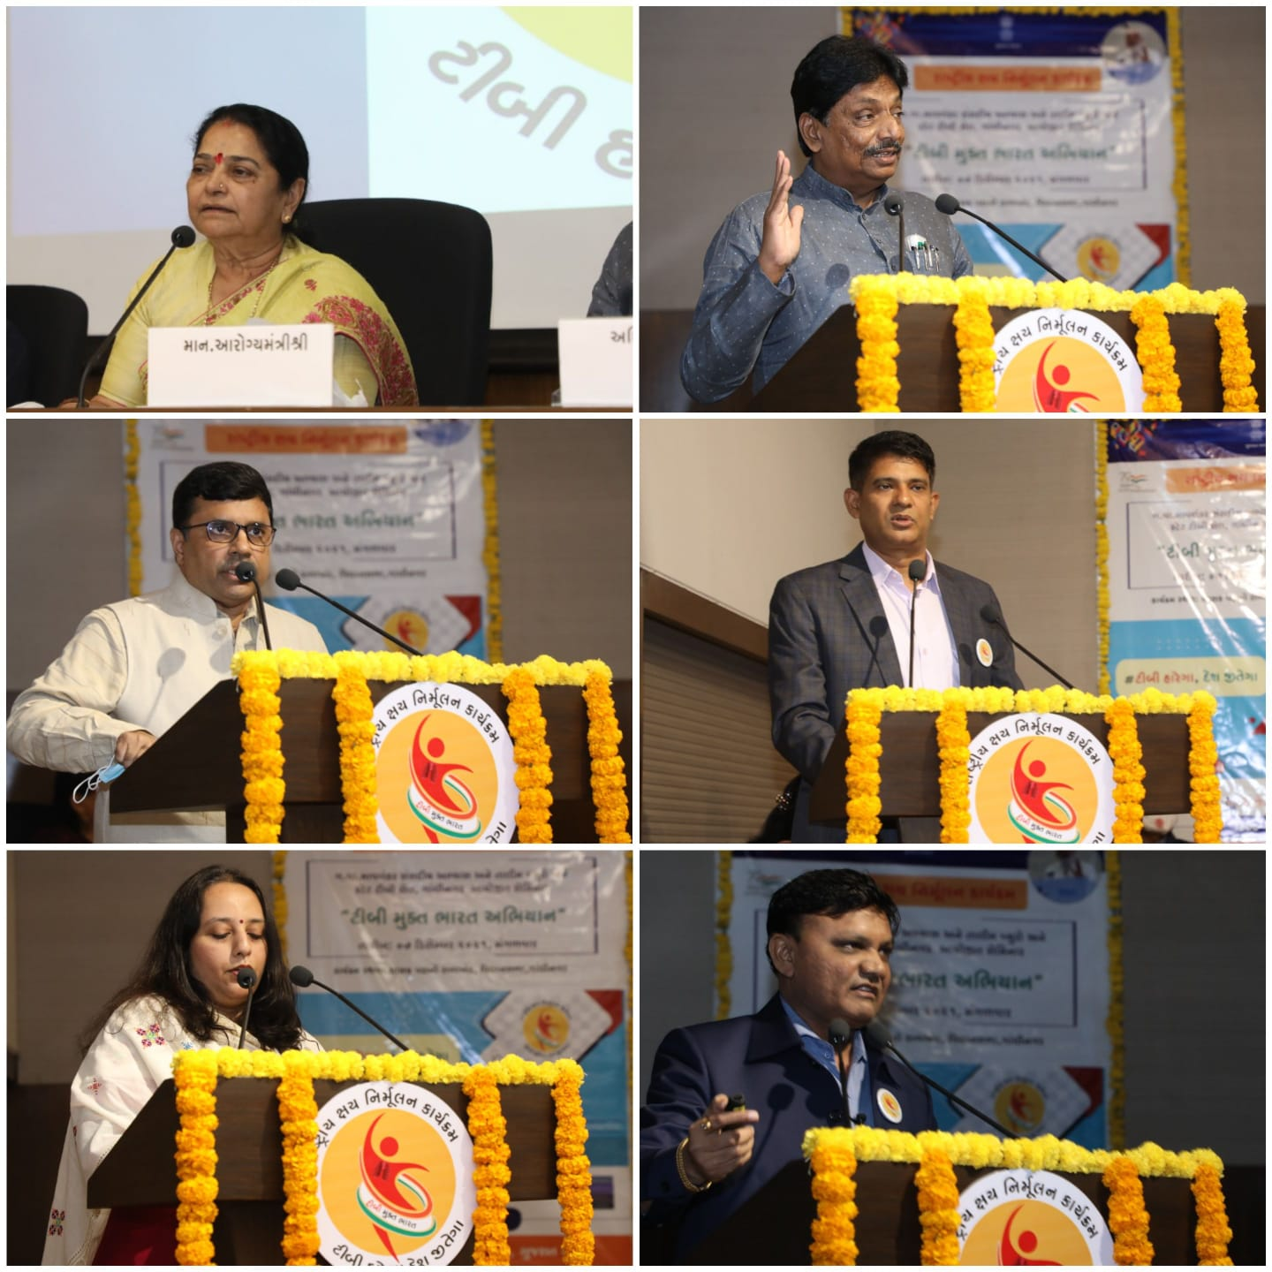
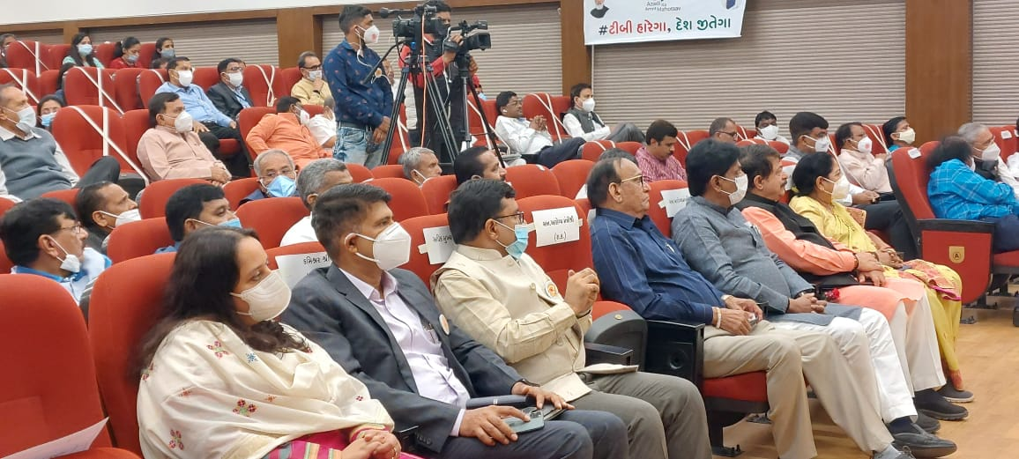
 | Global | India | Gujarat
Incidence | 10 Million | 26 Lakh | 1.45Lakh
Deaths | 1.2 Million | 4.4 Lakh | 5,472
HIV TB cases | 8.15 Lakh | 71000 | 3,212
HIV TB deaths | 2.08 Lakh | 9500 | 507
Estimated MDR/RR cases | 5.58 lakh | 1.30 lakh | 2,667

Slide 4
National Strategic Plan NSP (2017-25)
  Find all TB cases with an emphasis on reaching every TB patient in the private sector
Treat
Build
Detect
Prevent
  Treat all TB cases with high quality anti TB drugs
  Prevent the emergence of TB in susceptible populations and stop catastrophic expenditure due to TB by all
  Build and strengthen supportive systems including enabling policies, empowered institutions and human resources with enhanced capacities

Slide 5
Introduction of NTEP Gujarat
The Government of India initiated National Tuberculosis Control Programme (NTP) in 1962, which was implemented in Gujarat in year 1962.
The Objective was to reduce the morbidity and mortality due to tuberculosis to the extent that it no more remains a public health problem.
Review of NTCP was done in the year, 1992 in which the shortcomings of NTCP were taken care of.
Revised National Tuberculosis Control Programme with WHO recommended DOTS strategy (Directly Observed Treatment Short course chemotherapy) was adopted by the government of India in year 1993.
It was implemented as a pilot -project in rural area of Chanasma and Patan Taluka of Mehsana district in Gujarat.
After achieving its successful results this programme was expanded to all the districts of Gujarat in phased manner from 1998 and by April 2004, we have covered entire State under the RNTCP.
Implementation of New Technical and Operation guideline (2016)
82 TB free taluka identified for TB Free Activity (2 per districts)

Slide 6
Introduction of Innovation: Post treatment follow up (PTFU)
Need for post treatment follow up as per TOR/ MO module:
~10% of TB patients experience recurrence of TB within a year.
~11 % of the total TB patients notified have past history of TB.
PTFU of TB patients is recommended at 6, 12, 18, 24 months post successful treatment in Technical and operational guideline for TB control in India - 2016.
Objectives:
Early identification of TB recurrence and mortality (post treatment)
Set up a uniform system of conducting PTFU on large scale
To ensure relapse/ recurrence free survival post treatment

Slide 7
Pilot intervention
Geography – Surat rural, SMC and Gandhinagar
Duration – Oct 2020 to Oct 2021
Supported by – WHP in coordination with NTEP team Gujarat.
Multiple CTD level consultations/ meetings resulted in inclusion of PTFU in Nikshay for data entry

Slide 8
Rationale
Robust mechanism for monitoring/ data entry for PTFU was made available in Nikshay
Telephonic approach was uniformly accepted over physical visit due to large no of additional home visits otherwise needed
Notifications in a year in Gujarat | ~1,50,000
No of follow up needed to be done in a year | ~6,00,000
No of follow up needed to be done in a month | ~50,000
NTEP staff in Gujarat (STS + TBHV) | 549
No of follow up needed to be done per month per staff | ~91

Slide 9
Workflow for execution of PTFU
List generation for PTFU (Nikshay)
Telephonic screening possible
Symptomatic
Not evaluated - Home visit
Telephonic screening not possible
Conduct Home visit
Asymptomatic
Referral for diagnosis
Evaluated
Other illness
TB
Management as per NTEP
Management

Slide 10
Overall findings
Already recurrent (1,067) (5%)
Responded (20,214) (81%)
Died
(1,144) (6%)
Presumptive
(1,281) (6%)
Evaluated
(1,069) (83%)
Recurrent Identified
(173) (16%)
Attempted
(24,918)
Not respondes – 4,704 (19%)
Reasons for no response
Untraceable
Migrated/Out of district
Refused
Verbal autopsy to identify cause of death (related to TB or not)
Major reason: symptoms improved (e.g. common cold)
Other reasons: Limited mobility due to COVID pandemic

Slide 11
Recurrence and mortality
Recurrence among TB patients
Distribution among recurrent TB cases
PTFU interval | Post treatment Recurrence | Post treatment Case fatality
6 month (N=7,109) | 7.5% | 4.1%
12 month (N=5,862) | 5.7% | 5.4%
18 month (N=4,167) | 5.6% | 6.6%
24 month (N=3,076) | 4.6% | 8.5%
Post-treatment follow-up (months) | % of Total Recurrence identified | % of Total Recurrence (Cumulative) | % of death identified | % of total death (cumulative)
1-3 | 14% | 14% | 20% | 20%
4-6 | 26% | 40% | 24% | 44%
7-9 | 22% | 62% | 19% | 63%
10-12 | 11% | 73% | 14% | 77%
13-15 | 11% | 84% | 8% | 85%
16-18 | 6% | 89% | 7% | 92%
19-21 | 5% | 94% | 5% | 97%
22-24 | 3% | 97% | 3% | 99%
>24 | 3% | 100% | 1% | 100%
73% of total recurrence identified within 12 months
Notes:
3 to 6 is actually 4 to 6

Slide 12
Details of recurrence and mortality
Age | Sample |  | Recurrence % (N) | Death % (N)
<14 | 982 |  | 2% (24) | 1% (14)
15-30 | 9,380 |  | 6% (546) | 3% 261)
31-45 | 5,314 |  | 7% (371) | 6% (343)
46-60 | 3,083 |  | 7% (225) | 10% (303)
>60 | 1,451 |  | 4% (52) | 15% (223)
Gender
Female | 7,733 |  | 5% (384) | 4% (276)
Male | 12,465 |  | 7% (834) | 7% (867)
TG | 16 |  | -- (0) | -- (1)
Sector
Public | 15,179 |  | 7% (1052) | 6% (944)
Private | 4,490 |  | 3% (123) | 4% (171)
HIV
Reactive |  | 417 | 5% (20) | 10% (41)
Non-Reactive |  | 18,128 | 6% (1112) | 6% (1009)
Site | Sample | Recurrence % (N) | Death % (N)
Pulmonary | 13,878 | 7% (992) | 7% (970)
Extrapulmonary | 6,333 | 4% (226) | 4% (174)
Basis
Clinical | 9,643 | 3% (289) | 4% (382)
Microbiol. Confirmed | 10,571 | 9% (929) | 7% (762)
Type of regimen
New | 15,944 | 4% (659) | 5% (780)
Previously treated | 3,704 | 13% (471) | 9% (339)
PMDT | 566 | 16% (88) | 4% (25)
Treatment Outcome
Cured | 7,897 | 9% (733) | 606 (8%)
Treatment Completed | 12,317 | 4% (485) | 538 (4%)
Diabetic
Positive | 1129 | 6% (78) | 96 (8%)
Negative | 17843 | 6% (1054) | 538 (5%)

Slide 13
Learning / Challenges
Migration is two times more in 18 and 24 months group compared to 6 and 12 months group
Contact details of patients were available in physical register but not updated in Nikshay (especially for – pts diagnosed during 2018-19)
NTEP staff used to create new Nikshay IDs for subsequent episodes (instead of new episode ID)
Presumptive patients need to be followed actively for timely referral to PHI
Most common reason for patients not visiting PHI is improvement in symptoms (minor cold/cough). Other reasons include fear of COVID testing/isolation during pandemic
Collect additional mobile numbers and enter in Nikshay (for subsequent cohort month follow-up) is a good practice.

Slide 14
Cohort monitoring for PTFU
6 months post-treatment (2021)
12 months post-treatment (2022)
Excluding Died Pts, Diagnosed with TB and Currently on Treatment .
57 (4%)
Recurrent TB in Nikshay
95 (78%)
Evaluated
122 (8%) Presumptive
28 (30%) Recurrent TB identified
Died
62 (4%)
1487 (63%)
Responded
Eligible Patients
2373
61 (3%)
Additional Recurrence
99 (93%)
Evaluated
107 (6%) Presumptive
5 (5%) Recurrent TB identified
Additional Died
52 (3%)
1939 (87%)
Responded
Eligible Patients
2227
8 refused / Migrated
Note: The same patient will be followed up at the interval of 12,18 & 24 months who communicated in 6 months cohort.

Slide 15
Next steps
Update
Way forward
PTFU features live in Nikshay now.
Piloting PTFU by Nikshay Sampark team-CTD in district Junagarh & Vadodara – response is encouraging
Roll out in entire state (11 districts have already started)
Initiation of Death Audit intervention – verbal autopsy
Role of CHO in AB-HWC
Guidance from CTD
Technical guidance
Nikshay features on task list and dashboard for effective monitoring

Slide 16
Thanks

